Slide 1
Understanding Events In Natural Language:
-- Learning, Common Sense, Data Annotation, and What’s Next
Qiang Ning
Electrical and Computer Engineering
University of Illinois at Urbana-Champaign

Slide 2
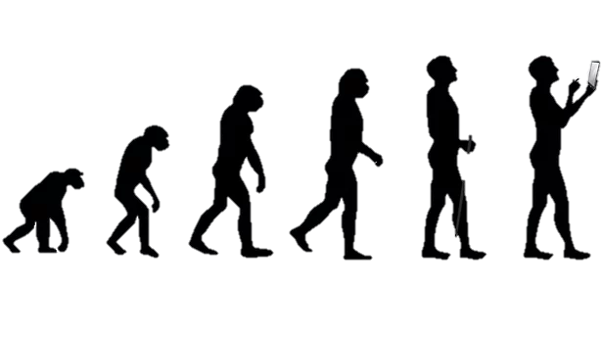
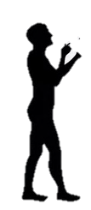
Why did Homo sapiens suddenly flood the earth?
Natural language!
2.5M ago
70K ago
12K ago
500 ago
Now
Multiple species of humans appeared
Cognitive
revolution
Agricultural revolution
Scientific revolution
Computer
revolution
Other species of humans
disappeared

Slide 3



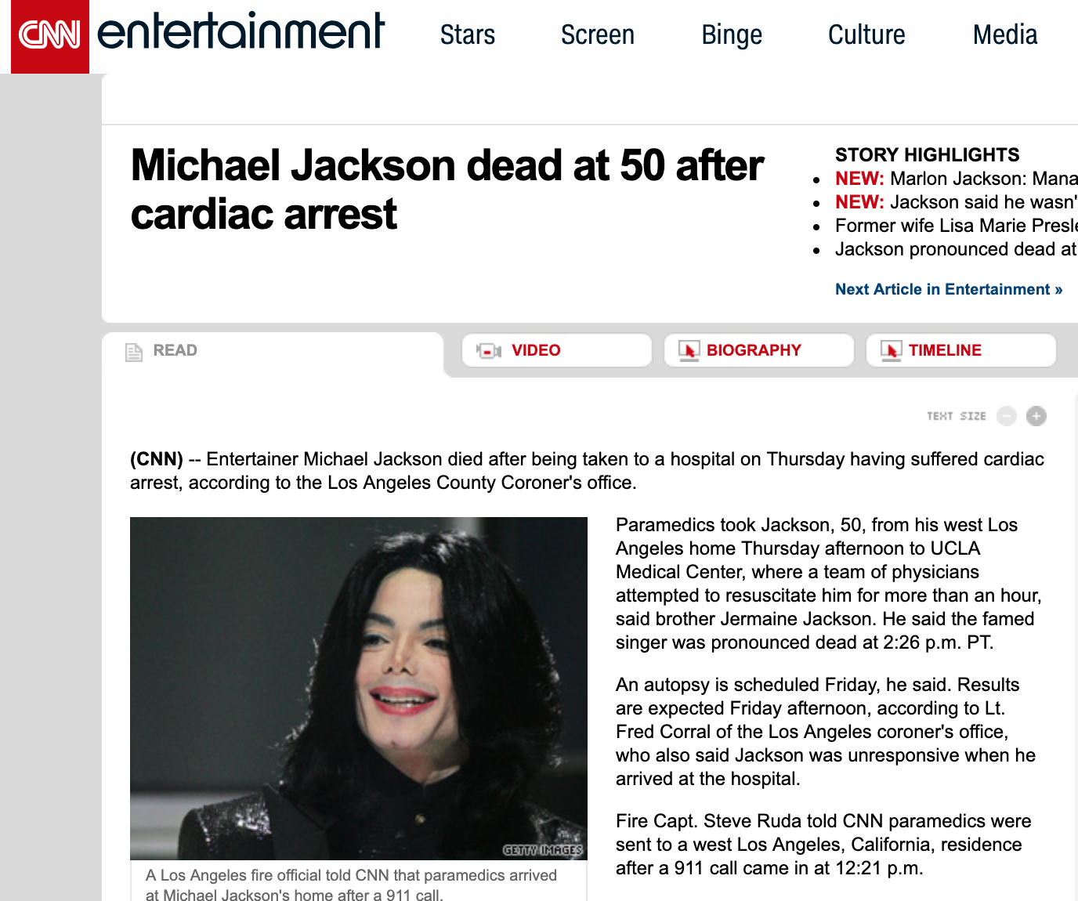
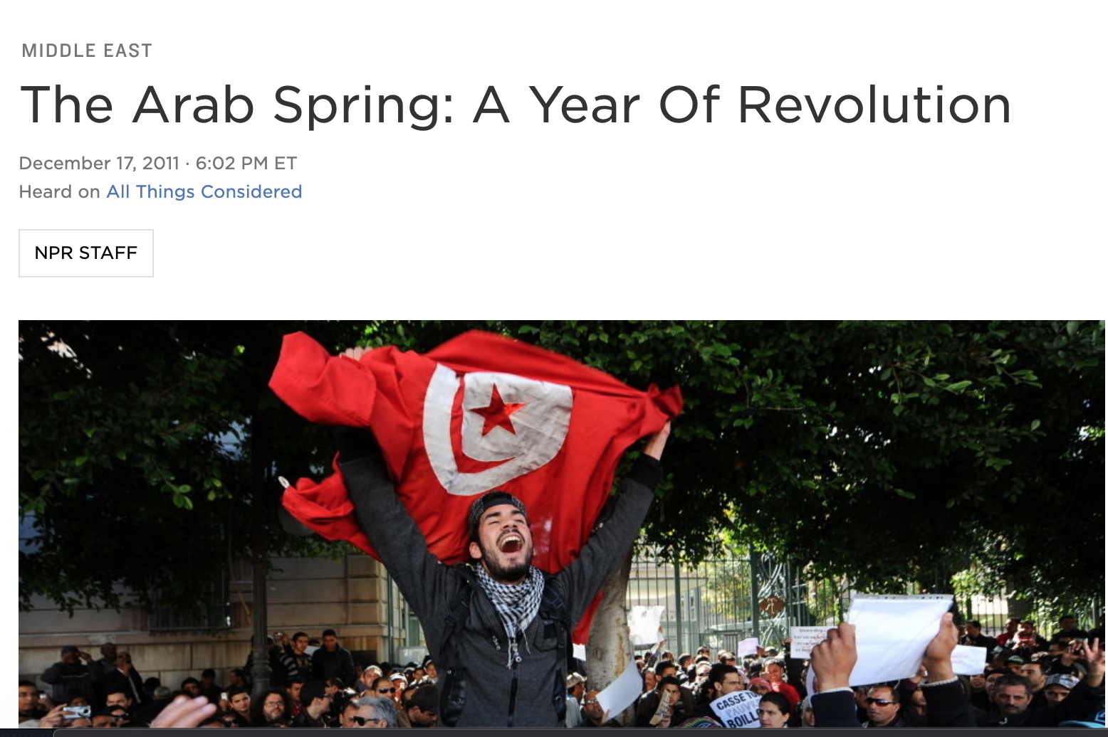
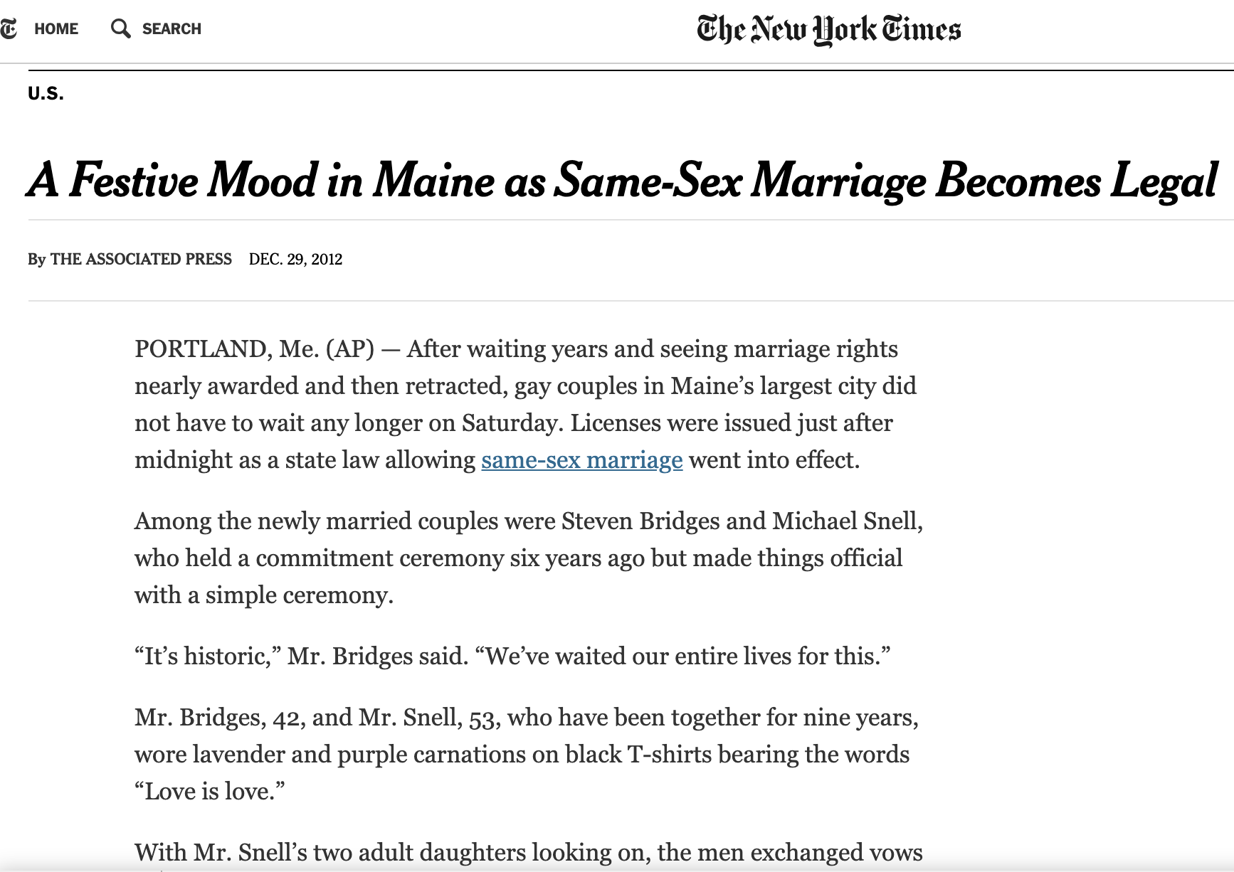
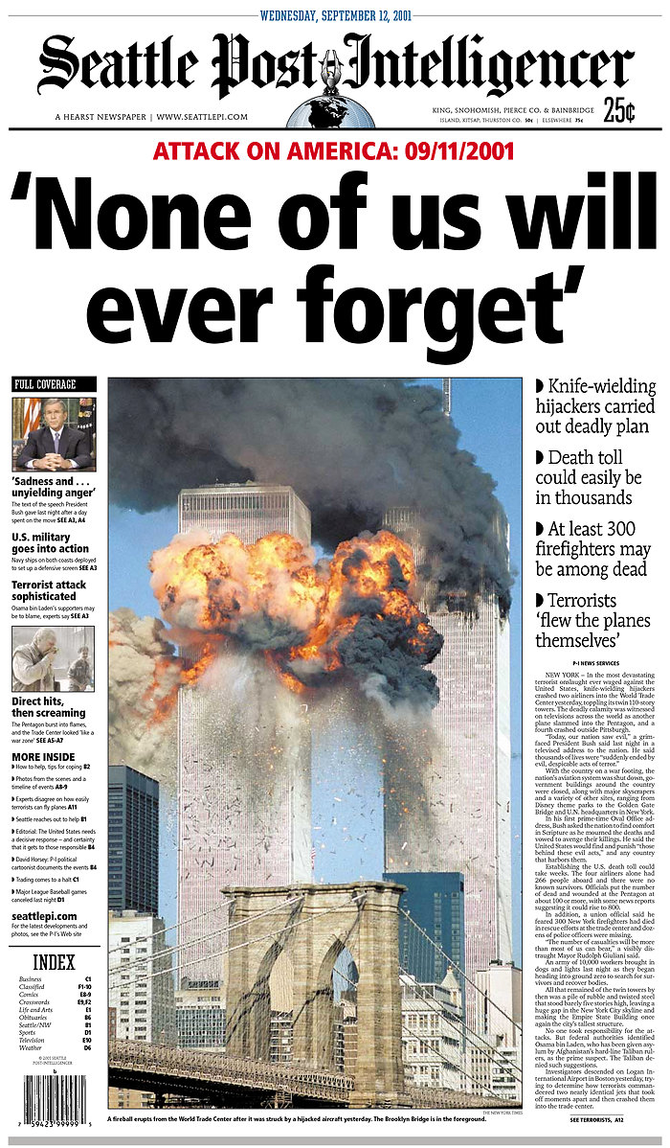




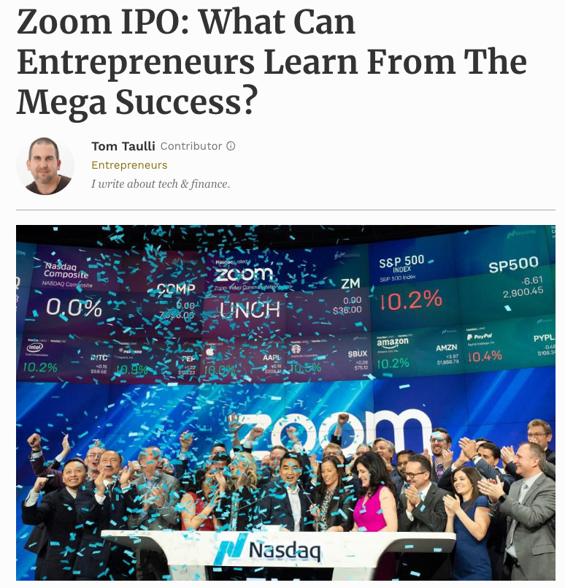

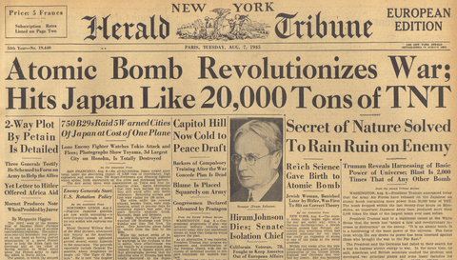

Slide 4
Every single day
1200 news stories
4000 papers
2M blog posts
500M tweets

Slide 5
Every single day
1200 news stories
Big Data
4000 papers
Big Text
2M blog posts
500M tweets
>80% of the world’s data unstructured text
[by breakthrough analysis]
Big text, big opportunities

Slide 6
Big text, big opportunities
If we manage to
assess the health of a company
study causality in medical records
read and compare multiple sources
perhaps we can
provide better diagnostics
fight against fake news
better predict the market trend
Legalzoom: Fake news, what laws are designed to protect
www.milesweb.com
Engineersjournal: BioInnovate Ireland Fellowship: innovating tomorrow’s medical devices

Slide 7
Natural language is natural for humans

Slide 8
Natural language is not natural for computers

Slide 9
Natural language is not natural for computers
Public Radio International (1998/02/13 Friday)
In Los Angeles that lesson was brought home Friday when tons of earth cascaded down a hillside, ripping two houses from their foundations. No one was hurt, but firefighters ordered the evacuation of nearby homes and said they'll monitor the shifting ground until March 23rd.
Who are they? Nearby homes?
Plural form of “home” as in “brought home”?
Same
Will they monitor until 2019/03/23?

Slide 10
Natural language is not natural for computers
Public Radio International (1998/02/13 Friday)
In Los Angeles that lesson was brought home Friday when tons of earth cascaded down a hillside, ripping two houses from their foundations. No one was hurt, but firefighters ordered the evacuation of nearby homes and said they'll monitor the shifting ground until March 23rd.
Who are they? Nearby homes?
Plural form of “home” as in “brought home”?
Same
Will they monitor until 2019/03/23?
NLP is to help computers resolve the ambiguity that are seemingly easy for humans

Slide 11
A brief overview of NLP
…
…
Situation
Events, Q&A, reasoning, …
Sentence
Syntactic parsing, semantic role labeling, language modeling, …
Token
Tokenization, lemmatization, POS tagging, chunking, …
Methodology
Machine learning, linguistics, …

Slide 12
A brief overview of NLP
Level
Accuracy
George Lowe died Wednesday after a long-term illness
George Lowe died Wednesday after a long-term illness

Slide 13
A brief overview of NLP
Level
Accuracy
George Lowe died Wednesday after a long-term illness
George Lowe died Wednesday after a long-term illness
Token
(POS)
NNP
NNP
VBD
NNP
IN
JJ
NN
>95%
DT
George Lowe died Wednesday after a long-term illness

Slide 14
A brief overview of NLP
Level
Accuracy
NAME
SBJ
ROOT
TMP
George Lowe died Wednesday after a long-term illness
George Lowe died Wednesday after a long-term illness
Sentence
(dependency)
~90%
TMP
NMOD
NMOD
PMOD
George Lowe died Wednesday after a long-term illness
Token
(POS)
NNP
NNP
VBD
NNP
IN
JJ
NN
>95%
DT
George Lowe died Wednesday after a long-term illness

Slide 15
A brief overview of NLP
Level
Accuracy
often >10 years
Person
Situation
Lowe: long-term illness --> died on 03-20-2013
Not robust
Wednesday
no activities after death
NAME
SBJ
ROOT
TMP
George Lowe died Wednesday after a long-term illness
Sentence
~90%
(dependency)
TMP
NMOD
NMOD
PMOD
George Lowe died Wednesday after a long-term illness
Token
NNP
NNP
VBD
NNP
IN
JJ
NN
>95%
(POS)
DT
George Lowe died Wednesday after a long-term illness

Slide 16
Where are we in NLP?
It’s time to study situation and event
  what is going on
  what is the cause and effect
  how things unfold along time
…
Now
Situation
~2010’s
Sentence
Robust
~2000’s
Token
~1990’s
Methodology
Machine learning

Slide 17
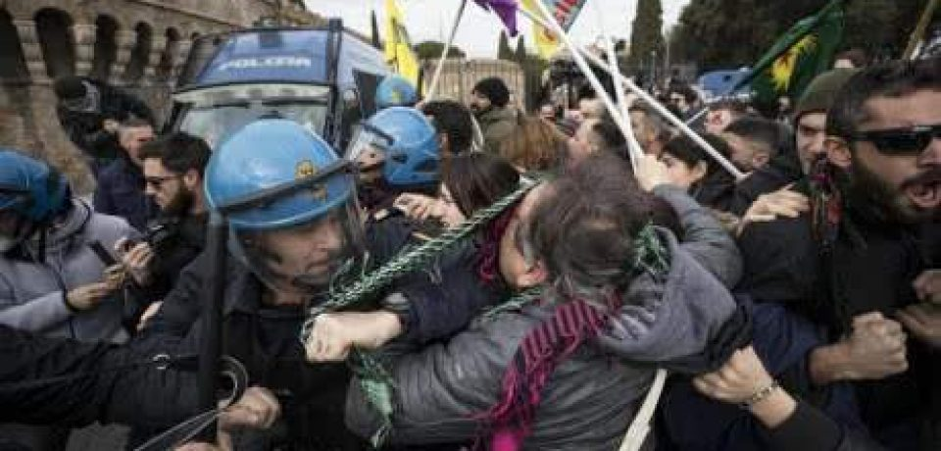
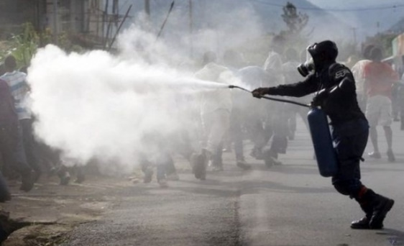
Let’s take a look at two events
People were angry
Police used tear gas
Time
People were angry at something (and ended in violent conflicts with the police)…The police finally used tear gas (to restore order).

Slide 18
Reversing them
Police used tear gas
People were angry
Time
Police used tear gas…People were angry at the police.

Slide 19
Reversing them
Police used tear gas
People were angry
Time
In natural language, we rarely have timestamps, so we have to figure out the order based on text.

Slide 20
Temporal relation (TempRel)
Event: An action or state headed by a verb
BE_INCLUDED
Tons of earth cascaded down a hillside, ripping two houses. Firefighters will monitor the shifting ground.
BEFORE
My talk mainly focuses on TempRel extraction

Slide 21
Multiple events form a situation
“Temporal Graph”
In Los Angeles that lesson was brought home Friday when tons of earth cascaded down a hillside, ripping two houses from their foundations. No one was hurt, but firefighters ordered the evacuation of nearby homes and said they'll monitor the shifting ground until March 23rd.
The task is to label those edges in temporal graphs.
ripping
monitor
This task is difficult:
Temporal relation extraction | Literature F1 (%)
w/ gold events | low 50’s
w/o gold events | low 30’s
hurt
cascaded
ordered
BEFORE
BE_INCLUDED

Slide 22
Challenges
My solutions
  Structured learning
Interrelated events
  If A<B and B<C, then A<C (time is transitive)
Lack of prior knowledge
  Common sense
  Humans have the common sense about the typical orders of events, even if a sentence doesn’t say so
  Data annotation
Insufficient data
  #edges is quadratic in terms of #nodes
Temporal relation extraction | Literature F1 (%)
w/ gold events | low 50’s
w/o gold events | low 30’s
Our F1 (%)
70’s
50’s

Slide 23



Structured learning
EMNLP’17, SEM’18
ACL’18 (a)
NAACL’19
EMNLP’18
NAACL’18
1 in submission
1 in submission
ACL’18 (b)
1 in submission
Common sense
Data annotation

Slide 24
  Understanding time for events
  Part I: Structured learning
    [EMNLP’17] Q. Ning, Z. Feng, and D. Roth. A Structured Learning Approach to Temporal Relation Extraction

Slide 25
Temporal graphs are structured
Due to transitivity, TempRels are not independent
Existing methods: global inference
ripping
monitor
ripping
monitor
ripping
ripping
monitor
monitor
monitor
cascaded
ordered
?
hurt
hurt
hurt
Time
ripping
ordered
ordered
cascaded
ordered
cascaded
cascaded
cascaded
cascaded
Must be before
BEFORE
INCLUDED
  Part I: Structured learning

Slide 26
Assume a model is already trained
Confidence/softmax
before: 0.4
after: 0.2
cascaded
ordered
model
includes: 0.1
( , )
included: 0.1
equal: 0.0
vague: 0.2
Based on these confidence scores, we need to solve for the final temporal graph.
  Part I: Structured learning

Slide 27
Global inference (a toy example)
monitor
0.6
0.7
Local inference:
Mani et al., 2006
Chambers et al., 2007
Bethard et al., 2007
0.4
0.3
cascaded
0.8
ordered
0.2
Time cannot be a loop!
  Part I: Structured learning

Slide 28
Global inference (a toy example)
monitor
0.6
0.7
Local inference:
Mani et al., 2006
Chambers et al., 2007
Bethard et al., 2007
cascaded
0.8
ordered
We should not only select the assignment with the best score, but also avoid loops
  Part I: Structured learning

Slide 29
Global inference (a toy example)
Option 1
Option 2
Option 3
monitor
monitor
monitor
0.6
0.7
0.4
0.7
0.6
0.3
cascaded
ordered
cascaded
ordered
cascaded
ordered
0.2
0.8
0.8
0.6+0.2+0.7=1.5
0.4+0.8+0.7=1.9
0.6+0.3+0.8=1.7
We should not only select the assignment with the best score, but also avoid loops
  Part I: Structured learning

Slide 30
Global inference (a toy example)
Option 2
monitor
monitor
monitor
0.6
0.7
0.4
0.7
0.6
0.3
cascaded
ordered
cascaded
ordered
cascaded
ordered
0.2
0.8
0.8
0.6+0.2+0.7=1.5
0.4+0.8+0.7=1.9
0.6+0.3+0.8=1.7
We should not only select the assignment with the best score, but also avoid loops
  Part I: Structured learning

Slide 31
Global inference (a toy example)
Option 2
monitor
monitor
monitor
0.6
0.7
0.4
0.7
0.6
0.3
cascaded
ordered
cascaded
ordered
cascaded
ordered
0.2
0.8
0.8
0.6+0.2+0.7=1.5
0.4+0.8+0.7=1.9
0.6+0.3+0.8=1.7
How should we formulate this procedure?
Global inference via ILP
[Roth & Yih, 2004]
  Part I: Structured learning

Slide 32
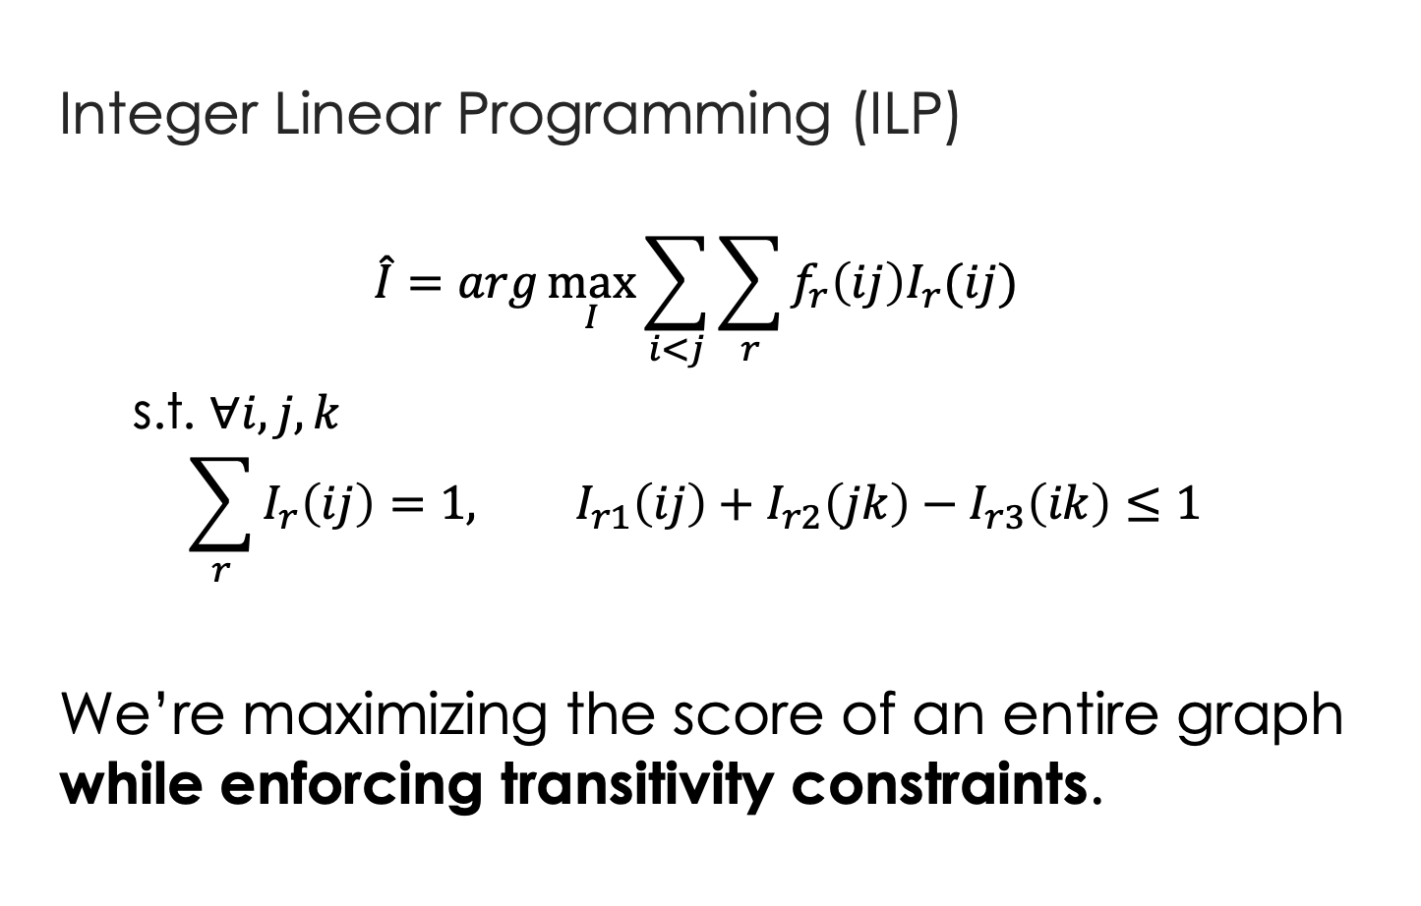




Global inference via ILP
$$I_{→}\left(ij\right)=1$$
$$f_{→}\left(ij\right)=0.6$$
Event i
j
$$f_{←}\left(ij\right)=0.4$$
Integer Linear Programming (ILP)
  $$\hat{I}=arg\max_{I}{\sum_{i<j}{\sum_{r}{f_{r}\left(ij\right)I_{r}(ij)}}}$$
  s.t. $∀i,j,k$
  $$\sum_{r}{I_{r}\left(ij\right)}=1, I_{r1}\left(ij\right)+I_{r2}\left(jk\right)−I_{r3}\left(ik\right)≤1$$
We’re maximizing the score of an entire graph while enforcing transitivity constraints.
$$I_{←}\left(ij\right)=1$$
real variable
boolean variable
Uniqueness
Transitivity (no loops)
Global inference for TempRel extraction: Bramsen et al., 2006. Chambers & Jurafsky, 2008. Denis & Muller, 2011. Do et al., 2012. Chambers et al., 2014. Mirza & Tonelli, 2016.

Slide 33
Benefit of global inference via ILP
5%
Global inference via ILP
Baseline
[UTTime] Laokulrat et al. *SEM’13. UTTime: Temporal relation classiﬁcation using deep syntactic features.
[Perceptron+ILP] Do et al. EMNLP’12. Joint inference for event timeline construction.
  Part I: Structured learning

Slide 34
How was the model trained?
Due to transitivity, TempRels are not independent
Existing methods: global inference
with local learning
ripping
monitor
ripping
monitor
ripping
ripping
monitor
monitor
monitor
cascaded
ordered
?
hurt
hurt
hurt
Time
ripping
ordered
ordered
cascaded
ordered
cascaded
cascaded
cascaded
cascaded
Must be before
BEFORE
INCLUDED
  Part I: Structured learning

Slide 35
Local learning in previous methods
Training Data
ripping
cascaded
ripping
hurt
cascaded
hurt
ordered
monitor
cascaded
ordered
Learning algorithm
ripping
monitor
ripping
ordered
Perceptron
SVM
Neural net
…
cascaded
monitor
hurt
monitor
BEFORE
INCLUDED
  Part I: Structured learning

Slide 36
Local learning is not sufficient
tons of earth cascaded down a hillside,
…ripping two houses…firefighters ordered the evacuation of nearby homes…
  Q: (ripping, ordered)=? (difficult even for humans)
  Annotation says “before”, so let’s update the parameters to fit it.
  which leads to overfitting
  No overfitting is needed anymore.
cascaded
ordered
Time
ripping
Must be before
Structured learning
  Part I: Structured learning

Slide 37

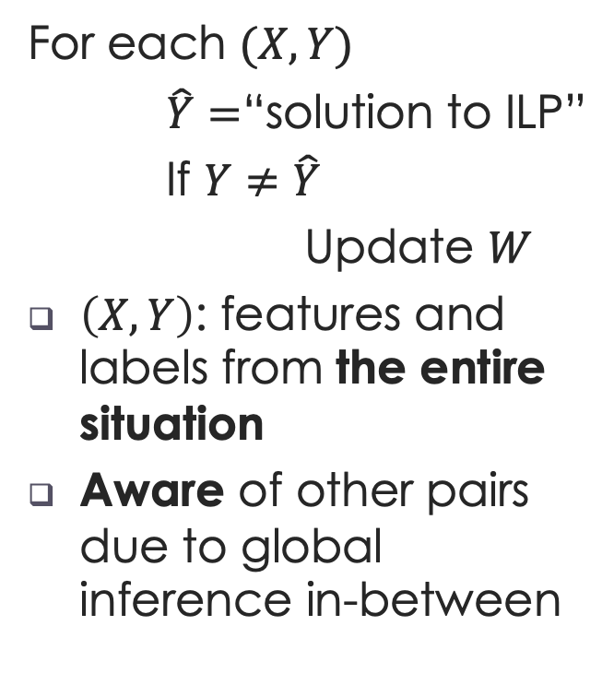
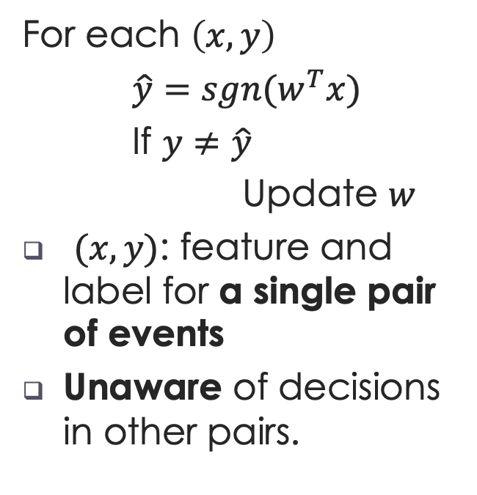
Structured (global) Learning
Local Learning
Structured Learning
[Collins, 2002]
For each $\left(x,y\right)$
$\hat{y}=sgn(w^{T}x)$
If $y≠\hat{y}$
Update $w$
$(x,y)$: feature and label for a single pair of events
Unaware of decisions in other pairs.
For each $(X,Y)$
$\hat{Y}=$“solution to ILP”
If $Y≠\hat{Y}$
Update $W$
$\left(X,Y\right)$: features and labels from the entire situation
Aware of other pairs due to global inference in-between
$$\hat{Y}=\underset{Y∈𝒞}{argmax}{W^{T}X}$$
  Part I: Structured learning

Slide 38
Results
5%
Global inference (ILP)
Local learning
[UTTime] Laokulrat et al. *SEM’13. UTTime: Temporal relation classiﬁcation using deep syntactic features.
  Part I: Structured learning

Slide 39
Results
We know which event pairs are related
5%
Structured learning
5%
Global inference (ILP)
Local learning
[UTTime] Laokulrat et al. *SEM’13. UTTime: Temporal relation classiﬁcation using deep syntactic features.
  Part I: Structured learning

Slide 40
Results
We don’t know which event pairs are related
?
Structure learning
+4%
Local learning
&
Global inference
[CAEVO] Chambers et al. TACL2014. Dense event ordering with a multi-pass architecture.
  Part II: Common sense

Slide 41
  Understanding time for events
  Part I: Structured learning
    [EMNLP’17] Q. Ning, Z. Feng, and D. Roth. A Structured Learning Approach to Temporal Relation Extraction

Slide 42
Relation extraction: general vs temporal
Conceptually, general relation extraction is of course harder, because “temporal” is only a subset of it.
However, existing works are limited to relations like place of birth, residence, or headquarter, marriage, and employment.
  do not require structural consideration in a situation (i.e., they are at the sentence-level)
  clearly defined by the context in a sentence

Slide 43
  Understanding time for events
  Part I: Structured learning
  Part II: Common sense
    [EMNLP’17] Q. Ning, Z. Feng, and D. Roth. A Structured Learning Approach to Temporal Relation Extraction
    [NAACL’18] Q. Ning, H. Wu, H. Peng, and D. Roth. Improving Temporal Relation Extraction with a Globally Acquired Statistical Resource

Slide 44
More than 10 people have (event1: died), police said. A car (event2: exploded) on Friday in a group of men in north Pakistan.

Slide 45
More than 10 people have (event1: died), police said. A car (event2: exploded) on Friday in a group of men in north Pakistan.

Slide 46
When events are …
… missing
More than 10 people have (event1: died), police said. A car (event2: exploded) on Friday in a group of men.
This turns out to be difficult.
  Part II: Common sense acquisition

Slide 47
When events are …
… present
More than 10 people have (event1: died), police said. A car (event2: exploded) on Friday in a group of men.
This turns out to be easy because humans have the common sense of which event “usually” happens before another.
We would like to acquire this common sense.
  Part II: Common sense acquisition

Slide 48
TemProb [NAACL’18]:
Temporal Relation Probabilistic Knowledge Base
To mimic human’s reading experience
New York Times 1987-2007, #Articles~1M
Ran our system on top of it (via AWS)
80M temporal relations
Simply by counting, we get
Example pairs |  | Time Before (%) | Time After (%)
Text Before | Text After
Ask | Help | 86 | 9
Attend | Schedule | 1 | 82
Accept | Propose | 10 | 77
Die | Explode | 14 | 83
  Part II: Common sense acquisition

Slide 49
Event distributions from TemProb
  Part II: Common sense acquisition

Slide 50
Event distributions from TemProb
  Part II: Common sense acquisition

Slide 51
Event distributions from TemProb
  Part II: Common sense acquisition

Slide 52
Event distributions from TemProb
  Part II: Common sense acquisition

Slide 53
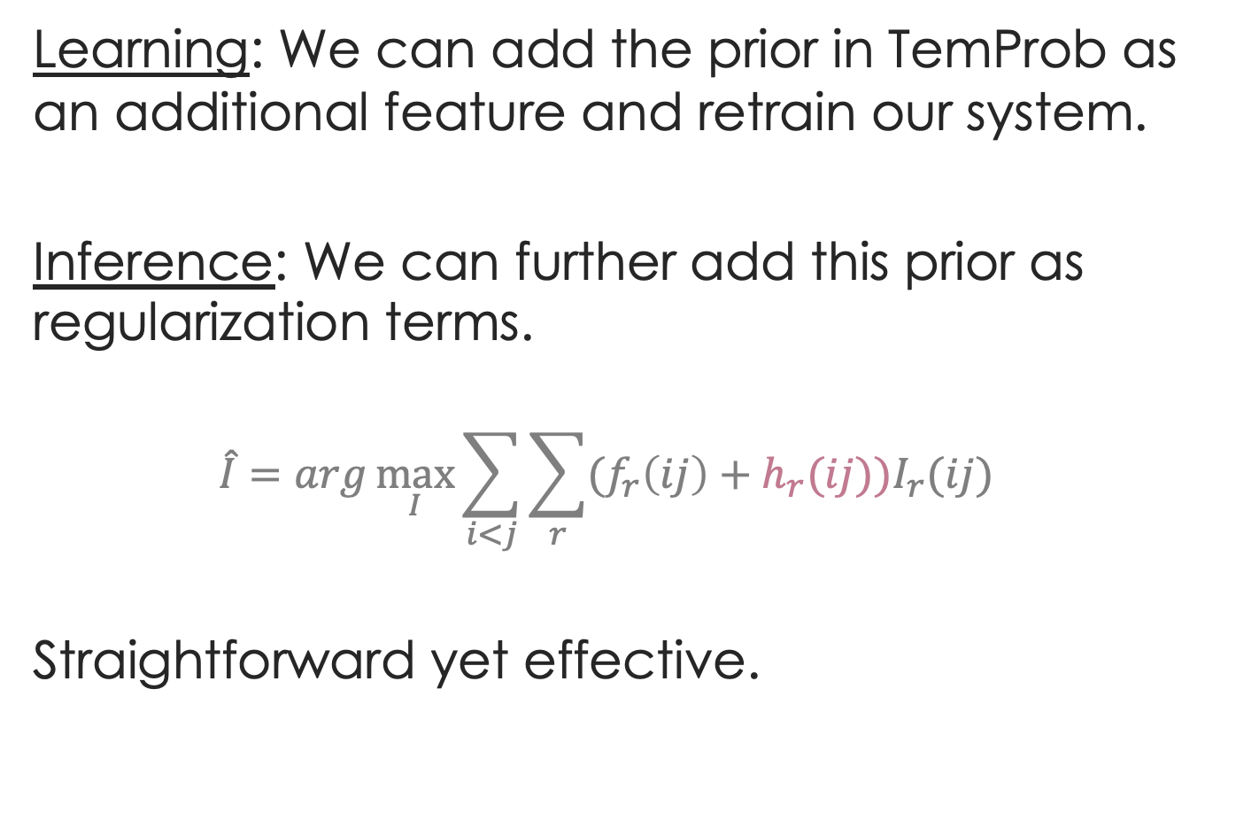
Apply TemProb in our task
Learning: We can add the prior in TemProb as an additional feature and retrain our system.
Inference: We can further add this prior as regularization terms.
  $$\hat{I}=arg\max_{I}{\sum_{i<j}{\sum_{r}{(f_{r}\left(ij\right)+h_{r}(ij))I_{r}(ij)}}}$$
Straightforward yet effective.
  Part II: Common sense acquisition

Slide 54
Further improvement by TemProb
TemProb
+4%
Structure learning
+4%
Local learning
&
Global inference
[CAEVO] Chambers et al. TACL2014. Dense event ordering with a multi-pass architecture.
  Part II: Common sense acquisition

Slide 55
  Understanding time for events
  Part I: Structured learning
  Part II: Common sense
    [EMNLP’17] Q. Ning, Z. Feng, and D. Roth. A Structured Learning Approach to Temporal Relation Extraction
    [NAACL’18] Q. Ning, H. Wu, H. Peng, and D. Roth. Improving Temporal Relation Extraction with a Globally Acquired Statistical Resource

Slide 56
  Understanding time for events
  Part I: Structured learning
  Part II: Common sense
  Part III: Data annotation
    [EMNLP’17] Q. Ning, Z. Feng, and D. Roth. A Structured Learning Approach to Temporal Relation Extraction
    [NAACL’18] Q. Ning, H. Wu, H. Peng, and D. Roth. Improving Temporal Relation Extraction with a Globally Acquired Statistical Resource
    [ACL’18] Q. Ning, H. Wu, and D. Roth. A Multi-Axis Annotation Scheme for Event Temporal Relations.

Slide 57
“Bottleneck”
The performance of temporal relation systems has come to a bottleneck. Even if we address this problem from structured learning and common sense, it’s still very low.
Bottleneck: size and quality of datasets
  Not scalable: requirement for expertise on this task (honestly, only the authors of those papers know how)
  Low inter-annotator agreement (IAA): low chance of agreement when people work on it without discussion
    TB-Dense: Cohen’s Kappa 56%~64%
    RED: F1<60%
    EventTimeCorpus: Krippendorff’s Alpha~60%
The annotation task was difficult even for the researchers who designed the annotation guidelines.
No more than 60%
  Part III: Data annotation

Slide 58
Existing annotation schemes
Police tried to eliminate the pro-independence army and restore order. At least 51 people were killed in clashes between police and citizens in the troubled region.
Annotation task: to label the TempRels between the bold faced events
Existing Scheme 1: TimeBank [Pustejovsky et al., 2003]
  Annotators freely add TempRels between those events.
  It’s inevitable that some TempRels will be missed.
  E.g., only one relation between “eliminate” and “restore” is annotated in TimeBank, while other relations such as “tried” is before “eliminate” and “tried” is also before “killed” are missed.

Slide 59
Existing annotation schemes
Police tried to eliminate the pro-independence army and restore order. At least 51 people were killed in clashes between police and citizens in the troubled region.
Existing Scheme 2: TimeBank-Dense [Cassidy et al., 2014]
  “All” – all event pairs are presented, one-by-one, and an annotator must provide a response for each of them.
  “1” – In the physical world, time is one dimensional.
  “0” – missing relations anymore.
  “?” – However, some pairs of events are very confusing, resulting in disagreement.
  Part III: Data annotation

Slide 60
Existing annotation schemes
Police tried to eliminate the pro-independence army and restore order. At least 51 people were killed in clashes between police and citizens in the troubled region.
E.g., what’s the relation between restore and killed?
  restore BEFORE killed?
  restore INCLUDES killed?
  restore AFTER killed?
  Part III: Data annotation

Slide 61
Proposed solution: multi-axis
Police tried to eliminate the pro-independence army and restore order. At least 51 people were killed in clashes between police and citizens in the troubled region.
We suggest that multiple time axes may exist in natural language.
Intention axis
restore order
✓
to eliminate army
✓
police tried
51 people killed
Main axis
✓
  Part III: Data annotation

Slide 62
Proposed solution: multi-axis
We complete a set of definitions for axes
Event Type | Axis Type | %
intention, opinion | orthogonal axis | ~20
hypothesis, generic | parallel axis | ~10
negation | not on any axis
static, recurrent | not considered now
main | main axis | ~70
  Part III: Data annotation

Slide 63
What we achieved
20k: Annotated the 20k relations
1 week: Finished in about one week using crowdsourcing (actual time much shorter)
80%: IAA improved from literature’s 60% to 80%, although those crowdsourcers are laymen in NLP
  Part III: Data annotation

Slide 64
With a better IAA (>80%)
The performance of a baseline system on our new dataset is much better than one on the old dataset
+22%
+21%
[Old dataset] Cassidy et al. ACL’14. An annotation framework for dense event ordering.

Slide 65
Discussion
With a better IAA, the overall performance on our new dataset is much better than those in the literature
The learning task is defined in a better way by the new annotation scheme
It represents a deeper understanding of how time is expressed in language
“Language distinguishes us from other species”
Wait…Animals also have language
Well, more precisely, we’re the only species that can express our imaginations via language
Banks get our money by promising us more in the future, but we cannot get a banana by promising a monkey two bananas in ten minutes
Intention, Opinion, Hypothesis, Negation, etc.
  Part III: Data annotation

Slide 66
  Understanding time for events
  Part I: Structured learning
  Part II: Common sense
  Part III: Data annotation
    [EMNLP’17] Q. Ning, Z. Feng, and D. Roth. A Structured Learning Approach to Temporal Relation Extraction
    [NAACL’18] Q. Ning, H. Wu, H. Peng, and D. Roth. Improving Temporal Relation Extraction with a Globally Acquired Statistical Resource
    [ACL’18] Q. Ning, H. Wu, and D. Roth. A Multi-Axis Annotation Scheme for Event Temporal Relations.

Slide 67
  Understanding time for events
  Put all pieces together
    [EMNLP’17] Q. Ning, Z. Feng, and D. Roth. A Structured Learning Approach to Temporal Relation Extraction
    [NAACL’18] Q. Ning, H. Wu, H. Peng, and D. Roth. Improving Temporal Relation Extraction with a Globally Acquired Statistical Resource
    [ACL’18] Q. Ning, H. Wu, and D. Roth. A Multi-Axis Annotation Scheme for Event Temporal Relations.
    [In submission] Q. Ning, S. Subramanian, and D. Roth. An improved neural approach for temporal relation extraction

Slide 68
  Put all pieces together
: initial try [EMNLP’18]
New Dataset
+11.1%*
Common sense
+4%
Structure learning
+4%
*Not a fair comparison because test set is re-labeled
  Put all pieces together

Slide 69
: a neural approach
  Put all pieces together
LSTM
+
Feed-Forward NN
+
Siamese
Siamese network
(Common sense)
Long short-term memory network
(Structured learning)
Feedforward network
(Trained on new data)
  Put all pieces together

Slide 70
  Put all pieces together
: a neural approach
LSTM takes word embeddings as input
Hidden vectors represent events
FFNN predicts the labels of temporal relations (followed by ILP inference)
Siamese network is a generalized TemProb
Siamese network
(Common sense)
LSTM
Feedforward network
(Trained on new data)
word embeddings
t₀ t₁ t₂ t_{n}
LSTM w/ concatenations of two hidden states
  Put all pieces together

Slide 71
  Put all pieces together
: a neural approach
LSTM takes word embeddings as input
Hidden vectors represent events
FFNN predicts the labels of temporal relations (followed by ILP inference)
Siamese network is a generalized TemProb
Siamese network
(Common sense)
h_{e1}
LSTM
128
word embeddings
h_{e2}
128
t₀ t₁ t₂ t_{n}
LSTM w/ concatenations of two hidden states
  Put all pieces together

Slide 72
  Put all pieces together
: a neural approach
LSTM takes word embeddings as input
Hidden vectors represent events
FFNN predicts the labels of temporal relations (followed by ILP inference)
Siamese network is a generalized TemProb
Siamese network
(Common sense)
h_{e1}
LSTM
128
output
before
after
equal
vague
word embeddings
h_{e2}
64
128
t₀ t₁ t₂ t_{n}
LSTM w/ concatenations of two hidden states
Output confidence scores
  Put all pieces together

Slide 73
  Put all pieces together
: a neural approach
LSTM takes word embeddings as input
Hidden vectors represent events
FFNN predicts the labels of temporal relations (followed by ILP inference)
Siamese network is a generalized TemProb
Siamese network trained on TemProb
v₁
v₂
500
500
150
dropout 0.3
45
dropout 0.3
h_{e1}
LSTM
128
output
before
after
equal
vague
word embeddings
h_{e2}
64
128
t₀ t₁ t₂ t_{n}
LSTM w/ concatenations of two hidden states
Output confidence scores
  Put all pieces together

Slide 74
  Put all pieces together
: a neural approach
LSTM takes word embeddings as input
Hidden vectors represent events
FFNN predicts the labels of temporal relations (followed by ILP inference)
Siamese network is a generalized TemProb
Siamese network trained on TemProb
v₁
v₂
500
500
150
dropout 0.3
45
dropout 0.3
h_{e1}
LSTM
128
output
before
after
equal
vague
word embeddings
h_{e2}
64
128
t₀ t₁ t₂ t_{n}
LSTM w/ concatenations of two hidden states
Output confidence scores
  Put all pieces together

Slide 75
  Put all pieces together
: a neural approach
Siamese
BERT
+3%
New dataset
Neural
+4%
Common sense
+3%
Structured learning
+11%*
Previous SOTA
+4%
+4%
*Test set is re-labeled
  Put all pieces together

Slide 76
  Put all pieces together
: a neural approach
Move fast!
Siamese
BERT
+3%
New dataset
Neural
+4%
Common sense
+3%
Structured learning
+11%*
Previous SOTA
+4%
+2%
*Test set is re-labeled
  Put all pieces together

Slide 77
  Put all pieces together
: a neural approach
Move slow to move fast!
Siamese
BERT
+3%
New dataset
Neural
+4%
Common sense
+3%
Structured learning
+11%*
Previous SOTA
+4%
+2%
*Test set is re-labeled
  Put all pieces together

Slide 78
Recap
Data
Learning
Prediction
Structured learning
Structure
EMNLP’17
1 in submission
NAACL’18
ACL’18
Common sense
Data annotation

Slide 79
Recap
Data
Learning
Prediction
Structured learning
Structure
EMNLP’17
1 in submission
NAACL’18
ACL’18
Common sense
Data annotation

Slide 80
Recap
Data
Learning
Prediction
Structured learning
Structure
EMNLP’17
Annotating structures
NAACL’19
1 in submission
NAACL’18
ACL’18
Common sense
Data annotation

Slide 81
Annotating structures
is important
Most NLP tasks are structured: Syntactic parsing (tree), semantic role labeling (assignment), temporal relation extraction (no loops)
A common perception is: “partial” data are of low quality and should be avoided
How should we quantify the quality of “partial”?
How should we quantify the quality of “partial”?
ripping
monitor
2 edges labeled
10 edges in total
hurt
cascaded
ordered
quality = 2 / 10?
BEFORE
BE_INCLUDED

Slide 82
How should we quantify the quality of “partial”?
ripping
monitor
quality = 2 / 10?
hurt
quality > 2 / 10!
cascaded
ordered
BEFORE
BE_INCLUDED
BE_INCLUDED
AFTER
BEFORE
INCLUDES
EQUAL
ripping
monitor
monitor
cascaded
Time
The existing two links has partly explained the red link.

Slide 83
Silver lining of “partial”
ripping
monitor
hurt
quality > 2 / 10!
cascaded
ordered
BEFORE
BE_INCLUDED
BE_INCLUDED
AFTER
BEFORE
INCLUDES
EQUAL
ripping
monitor
monitor
cascaded
Time
So, is “partial” even better than “complete”?

Slide 84
Partial or complete, that’s the question [NAACL’19]
Training Phase
(a) Complete
(b) Partial
same budget
same budget
$$𝒯_{test}$$
Testing Phase

Slide 85
Partial or complete, that’s the question [NAACL’19]
Training Phase
(a) Complete
(b) Partial
same budget
same budget
partial
complete
+: p<5%
++: p<1%
$$𝒯_{test}$$
++
++
++
++
++
++
++
++
+
Testing Phase
When we have a fixed budget, partial structures indeed lead to better performance.
How should we quantify the quality of “partial”?
  Partial or complete? [NAACL’19]

Slide 86

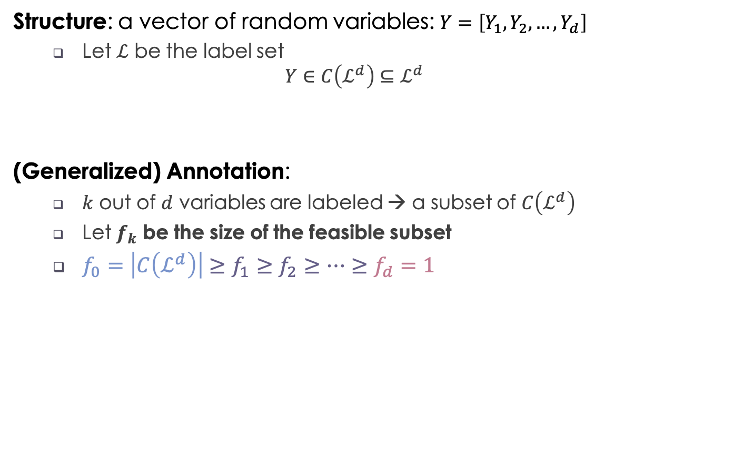

The quality of partially annotated structures
Structure: a vector of random variables: $Y=\left[Y_{1},Y_{2},…,Y_{d}\right]$
  Let $ℒ$ be the label set
  $$Y∈C\left(ℒ^{d}\right)⊆ℒ^{d}$$
(Generalized) Annotation:
  $k$ out of $d$ variables are labeled → a subset of $C\left(ℒ^{d}\right)$
  Let $f_{k}$ be the size of the feasible subset
  $f_{0}=\left|C\left(ℒ^{d}\right)\right|≥f_{1}≥f_{2}≥⋯≥f_{d}=1$
Not all assignments are valid (e.g., no loops in time)
$f_{k}$ be the size of the feasible subset
No annotation
Complete annotation
1
1→2→3→4
Or
1→3→2→4
2
3
$$f_{k}=2$$
Partial order
4
  Partial or complete? [NAACL’19]

Slide 87
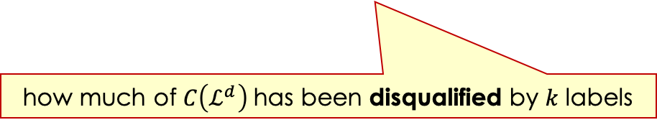


The quality of partially annotated structures
Structure: a vector of random variables: $Y=\left[Y_{1},Y_{2},…,Y_{d}\right]$
  Let $ℒ$ be the label set
  $$Y∈C\left(ℒ^{d}\right)⊆ℒ^{d}$$
(Generalized) Annotation:
  $k$ out of $d$ variables are labeled → a subset of $C\left(ℒ^{d}\right)$
  Let $f_{k}$ be the size of the feasible subset
  $f_{0}=\left|C\left(ℒ^{d}\right)\right|≥f_{1}≥f_{2}≥⋯≥f_{d}=1$
Define the benefit of k labels: $I_{k}≜\log{|C(𝓛^{d})|}−E[\log{f_{k}}]$
Not all assignments are valid (e.g., no loops in time)
$f_{k}$ be the size of the feasible subset
No annotation
Complete annotation
$$I_{k}≜\log{|C(𝓛^{d})|}−E[\log{f_{k}}]$$
how much of $C\left(ℒ^{d}\right)$ has been disqualified by 𝑘 labels
  Partial or complete? [NAACL’19]

Slide 88
Diminishing return of new labels
$$I_{k}:\text{The} \text{benefit} \text{of} \text{k} \text{label}\text{s} \text{is} \text{concave}$$
$$Δ_{k}=I_{k}−I_{k−1} \text{: }\text{The} \text{benefit} \text{of} \text{a} \text{new} \text{label} \text{is} \text{diminishing}$$
  Partial or complete? [NAACL’19]

Slide 89
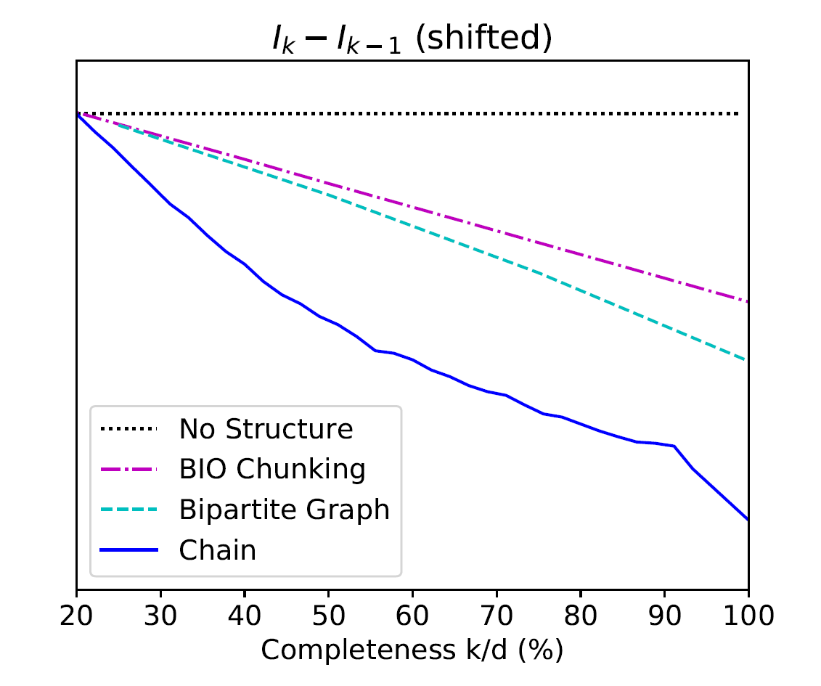
The more concave $I_{k}$ is, more benefit partial brings!
$$Δ_{k}=I_{k}−I_{k−1} \text{: }\text{The} \text{benefit} \text{of} \text{a} \text{new} \text{label}$$
Seq Tagging
(chunking)
partial
complete
Seq Tagging
complete
partial
more concave
Bipartite Graph
(semantic role classification)
Chain
(temporal relation extraction)
partial
partial
complete
complete
complete
complete
partial
partial

Slide 90
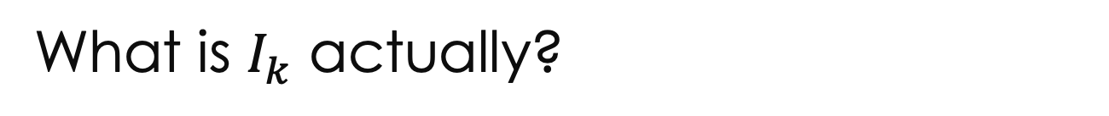
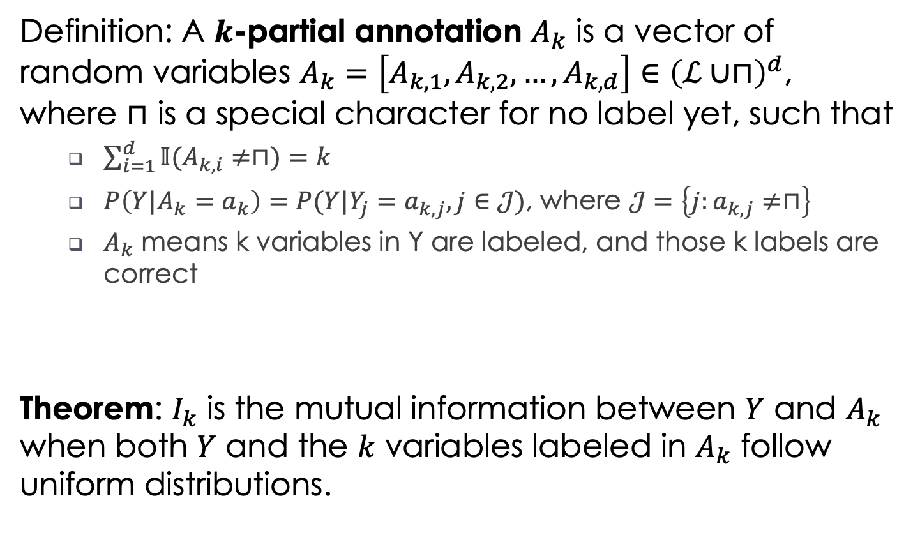
What is $I_{k}$ actually?
Definition: A $k$-partial annotation $A_{k}$ is a vector of random variables $A_{k}=\left[A_{k,1},A_{k,2},…,A_{k,d}\right]∈{\left(ℒ∪⊓\right)}^{d}$, where $⊓$ is a special character for no label yet, such that
  $\sum_{i=1}^{d}{𝕀(A_{k,i}≠⊓)}=k$
  $P\left(Y|A_{k}=a_{k}\right)=P(Y|Y_{j}=a_{k,j},j∈𝒥)$, where $𝒥=\left\{j:a_{k,j}≠⊓\right\}$
  $A_{k}$ means k variables in Y are labeled, and those k labels are correct
Theorem: $I_{k}$ is the mutual information between $Y$ and $A_{k}$ when both $Y$ and the $k$ variables labeled in $A_{k}$ follow uniform distributions.
  Partial or complete? [NAACL’19]

Slide 91
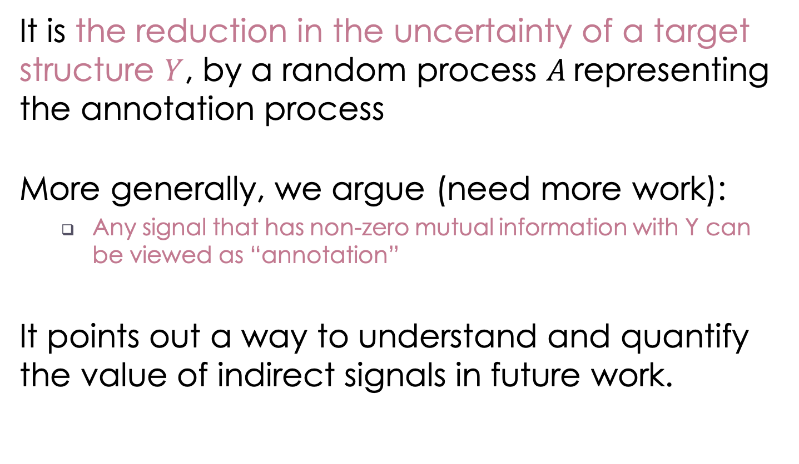
Unique view of structured annotation
It is the reduction in the uncertainty of a target structure $Y$, by a random process $A$ representing the annotation process
More generally, we argue (need more work):
  Any signal that has non-zero mutual information with Y can be viewed as “annotation”
It points out a way to understand and quantify the value of indirect signals in future work.
Incidental supervision
  Partial or complete? [NAACL’19]

Slide 92
Achilles heel of standard paradigms
Task
Data
Learn
Task
Data
Learn
Not scalable
Task
Data
Learn
Task
Data
Learn
Task
Data
Learn
Task
Data
Learn
Task
Data
Learn
Task
Data
Learn
Task
Data
Learn
Task
Data
Learn
Task
Data
Learn
Task
Data
Learn
Incidental supervision is the idea of learning from indirect signals, which may be partial, noisy, or only correlated.
My vision is that situation-level tasks will require gigantic training data, and at that time, incidental supervision will be crucial for them.

Slide 93
What’s next
Structured learning
Incidental supervision
Common sense
Data annotation

Slide 94
What’s next
Time
Joint extraction of events & relations
Multi-task & structured learning
Structured learning
Temporal common sense
Duration, frequency, …
Common sense
Data annotation
Multi-axis temporal parser
Important for information trustworthiness

Slide 95
Temporal common sense
[in submission]
TemProb [NAACL’18] is only about temporal ordering
In addition, we proposed other types of temporal common sense:
  Duration: how long something takes
  Frequency: how often something happens
  Stationary vs transient: “being allergic” vs “being a student”
  Absolute time point: “go to work” vs “go to bed”
We are the first to study this, have collected 10K Q&A pairs, and have achieved ~70% on it in a baseline system
“My movie starts in 30 mins. Can I have dinner before it?”
  What’s next: preliminary results

Slide 96
What’s next
Predict how things unfold [in submission]
Summarization [ISIT’19]
Event
Extension: Medical records, social events, etc.
Information theory for text summarization
Joint extraction of events & relations
Time
Temporal common sense
Multi-axis temporal parser
Event hierarchies, coreference, causality, etc.

Slide 97
What’s next
Robotics
Event
Biomedicine
Information theory
Time
Optimization
Deep learning
Statistics
Short-term: build a more robust temporal parser
Mid-term: study event understanding problems, e.g., text summarization, timeline construction, event hierarchies, and common sense.
Long-term: understand the social, political, medical, and financial events expressed in text; provide a semantic engine for reasoning about situations.
Incidental supervision

Slide 98
Summary
Big text, big opportunities
We are standing at the situation-level of NLP
Temporal relation is a crucial component
  Structured learning [EMNLP’17]
  Common sense knowledge acquisition [NAACL’18]
  New definition of the task [ACL’18]
  Combined them by neural nets [in submission]
Besides future work on time and event, incidental supervision is also necessary for situation understanding.
  Supervision from partial structures [NAACL’19]
3rd wave of AI

Slide 99
References
Harari, 2016. Sapiens: A Brief History of Humankind
Mani et al., 2006. Machine learning of temporal relations
Chambers et al., 2007. Classifying temporal relations between events
Bethard et al., 2007. Timelines from text: Identification of syntactic temporal relations
Roth & Yih, 2004. A linear programming formulation for global inference in natural language tasks
Bramsen et al., 2006. Inducing temporal graphs
Chambers & Jurafsky, 2008. Jointly combining implicit constraints improves temporal ordering
Denis & Muller, 2011. Predicting globally-coherent temporal structures from texts via endpoint inference and graph decomposition
Chambers et al., 2014. Dense event ordering with a multi-pass architecture
Mirza & Tonelli, 2016. CATENA: CAusal and TEmporal relation extraction from NAtural language texts
Do et al., 2012. Joint inference for event timeline construction
Laokulrat et al., 2013. UTTime: Temporal relation classiﬁcation using deep syntactic features
Collins, 2002. Discriminative training methods for hidden Markov models: Theory and experiments with perceptron algorithms
Pustejovsky et al., 2003. The TIMEBANK corpus
Cassidy et al., 2014. An annotation framework for dense event ordering

Slide 100
